Slide 1
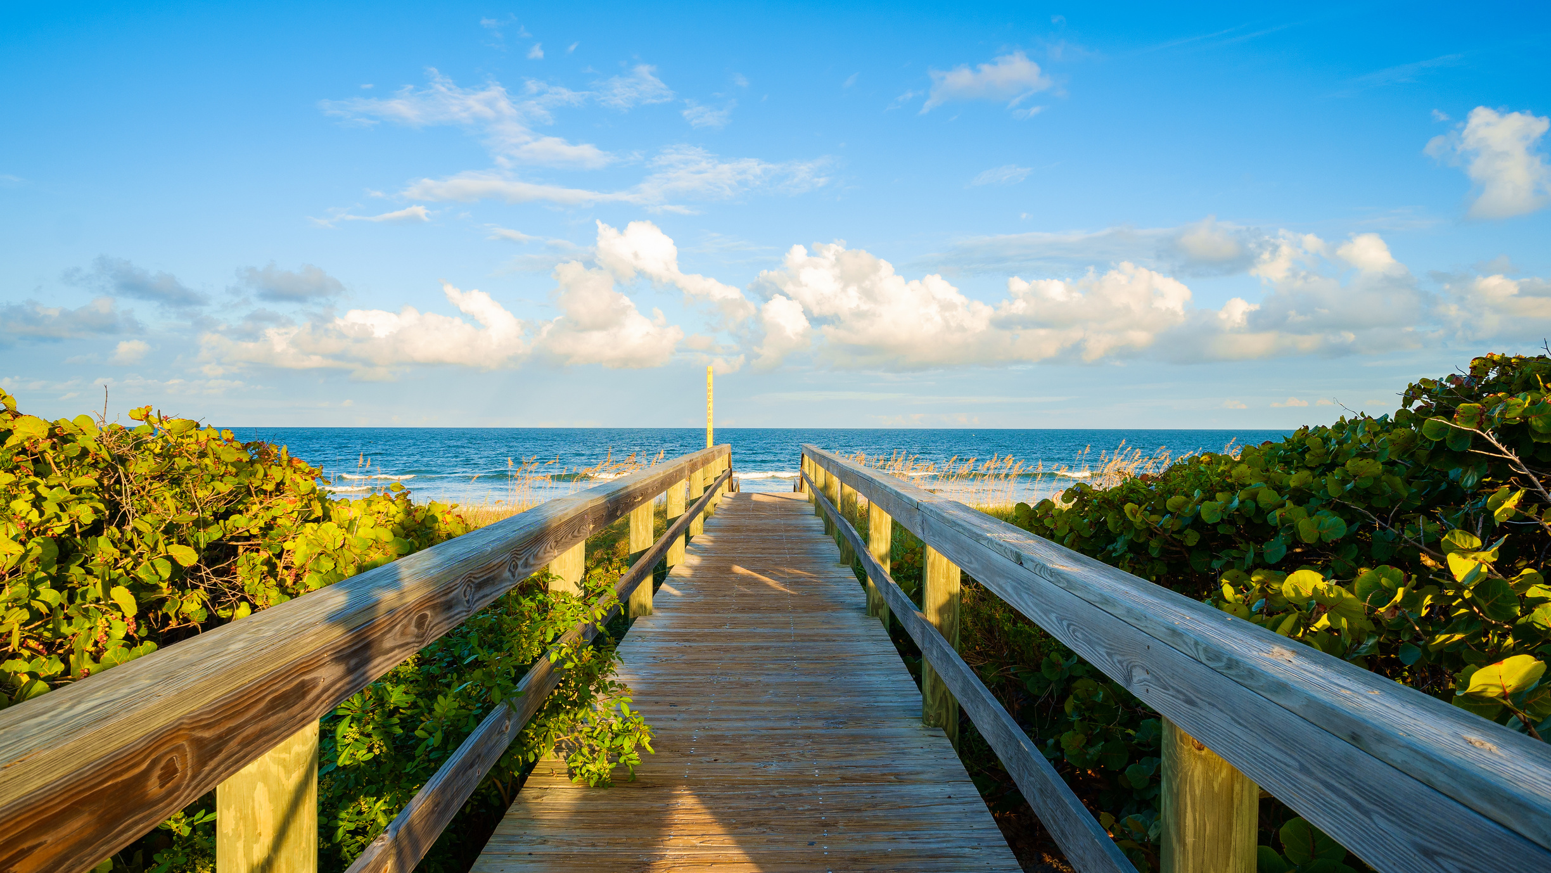


FINAL PRESENTATION
Suffolk University Boston
Sawyer School of Business
MKT-898-AE-Consulting Project
Fall Semester 2022
Instructor: Dr. Zhen Zhu
Team 3
Le Phuc Cao (Danny), Chi Hoang (Celine),
Pooja Jeeva, Ngoc Le (Hannah), Mei-Lin McCarthy, Thanh Phung (Sophie), Ruthvik Talluri

Slide 2
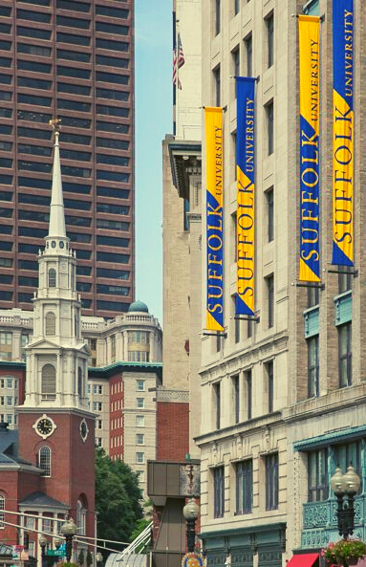
TABLE OF CONTENT.
01. Research question
02. Methodology
03. Persona
04. Empathy Map
05. MVP Demo
06. Marketing Planning
07. Project Launch
08. Roadmap
09. Sustainability

Slide 3

RESEARCH QUESTION
Create a data-driven solution to help visualize the risks of climate change to their communities and the impacts of implementing mitigation and adaptation strategies.

Slide 4

RESEARCH QUESTION
What preparedness and response strategies do the community have for extreme weather events?
What methods does the community use to collect information about extreme weather events?
What are the most common climate change issues in the community, and which are the most difficult to handle?
Is any specific app or tool recommended in extreme weather conditions to help preparedness?

Slide 5




METHODOLOGY
Background Research
User Advocate Interview
Data Exploration
Concept Validation
Notes:
We used the Data/resources gathered from our user advocate interviews and also carried out our secondary research methods and analysed the over all findings
From our research we concluded out target audience would be baby boomers as they are the most vulnerable population during EWEs
For the concept validation - we survey our target group of 100 baby boomers using MTurk and we got feedbacks for our initial ideas and that were very useful as we were able to understand what the users like and don't like and take that into account to finish our final demo

Slide 6
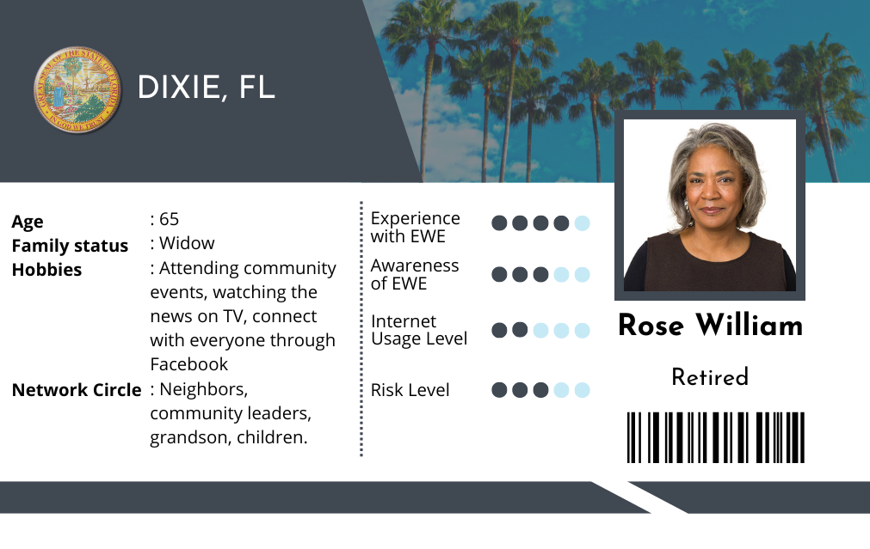

PERSONA
Notes:
Place, age, hobbies and risk level only

Slide 7
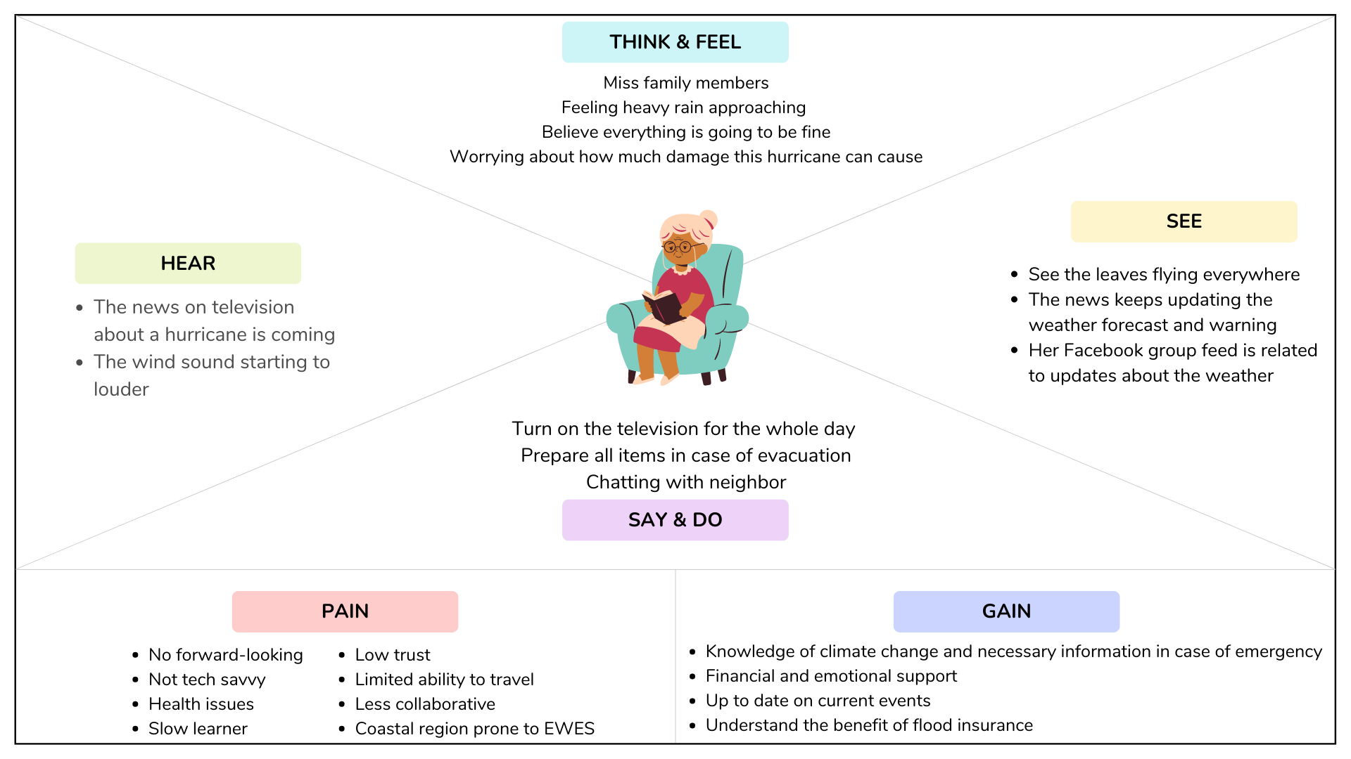
Notes:
we created empathy map to create a product that suits the persona

Slide 8
Notes:
we combined these pain points into 3 main challenges that our solution will address: lack of communication, lack of trust, and lack of education

Slide 9
Notes:
main : 1. Gain more knowledge and necessary information on climate change
2. up to date on current events

Slide 10

MVP
DEMO
Notes:
With all that we have discussed so far , we are now going to be leading on to a MVP demo that we created using our persona to showcase our main product i’e localised In-person events

Slide 11

The Video

Slide 12






C
A
C
MARKETING PLANNING
Marketing Mix
D
O
R

Slide 13

MARKETING PLANNING
Relative Advantage
A fun way to learn about hurricane preparedness
Develop a community
Understanding from the experts
Build and create a hidden core memory
A

Slide 14
MARKETING PLANNING
Compatibility
Baby boomers prefer Facebook to stay updated on community events
Minimize Baby Boomer's fear and worries by utilizing games and scenarios they are already familiar and comfortable with
C

Slide 15
MARKETING PLANNING
Communicability
Outreach to nearby senior living communities and leverage community leaders
Utilize data analysis and data visualizations to find interesting statistics
Advertising events through social media will help minimize costs
C

Slide 16
MARKETING PLANNING
Observability
Baby Boomers are young at heart and will appreciate a fun event.
Social and active events help Baby Boomers stay healthy
O

Slide 17
MARKETING PLANNING
Riskiness
Health reasons prevent them from attending the event
Financial loss if there were purchases made on behalf of those attendees
R

Slide 18
MARKETING PLANNING
Divisibility (Triability)
The event’s date and time frame
Location
D

Slide 19
Easy to use
911 call center
TV News
Live Event
Emergency text support
Climate news website
Weather dashboard
Warning sign
Community social group
Information handbook
PRODUCT
POSITIONING
Uninformative
Informative
Disater Navigation App
Hard to use

Slide 20
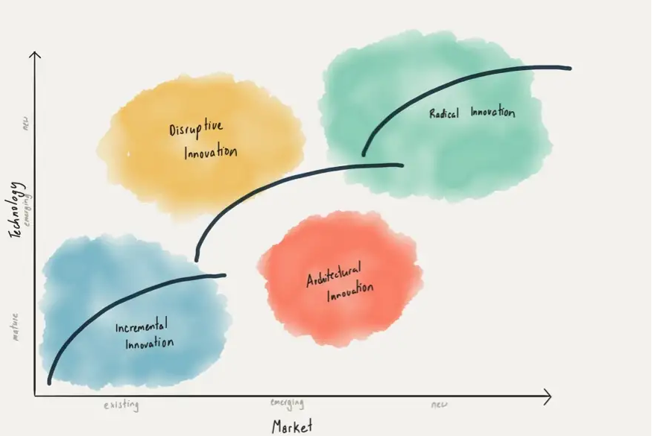
PERCEPTION
MATRIX
Incremental Product
Utilize existing technologies
Leverage government datasets to provide relevant information to the communities
Promote digital resources for climate resilience

Slide 21
PERCEPTION
MATRIX
Incremental Product
Provide value to the existing market
Target communities affected by extreme weather events
Provide education and information for extreme weather preparation

Slide 22






SHORTERM STRATEGY PLAN
Utilize Student Organizations to Manage
Suffolk in the Hub
MSM Ambassador Program
Partner with local farms and small businesses
A marketing mix is the actions brands take to market their products and services by using a specific framework with the five biggest components of successful marketing
Provide food coupons
Low-Cost Advertising / Rollout
Digital + Traditional Marketing (Social Media, Posters, etc.)
Outreach to extremely vulnerable cities
Local town halls and nearby community colleges
First Launch - May/June 2023

Slide 23
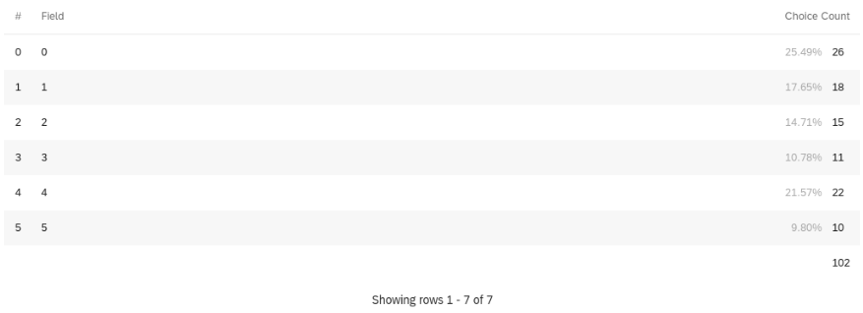
CONJOINT ANALYSIS
Q: How likely are you to join this event (poster one opinion)?
(1 being not very likely and
5 being definitely)
(9.8%)*80% + (21.57%)*30% = 14.31% market share for poster 1
Poster 2 is more favorable by 1.77 times
=> Potential market share =(54.46/30.69)*14.31 = 25.39%
Notes:
We calculate market projection using top-two box analysis, which based on customer survey.
When we surveyed the likelihood to join if they saw poster 1, 9.8% chose 5 (very likely to join) and 21.57% chose 4 => we have 14.31% market share for this option.
Poster 2 is also reported to be more favorable by 1.77 times
=> Market share if we use poster 2, and also the projected market share would be 25.39%

Slide 24
PROJECTION AND ASSESSMENT OF LAUNCHING SUCCESS
Dixie County, FL - Total 65+ population: 4104
Scenarios | KPIs | Actions
Best | New users: 2,100Returning: 80% - 1700Customer satisfaction: 95-100%Partnership: > 3 organizations | Take advantages of the growth rate to reach to national levels, for example reaching out to big firms, state organizations, etc,.
Average | New users: 1,100 (1)Returning: 34% - 355Customer satisfaction: 75-85%Partnership: 1-2 organizations | Continue developing sustainability package to enable more replication of the event
Worst | New users: 550 Returning: 15% - 85Customer satisfaction: <50%Partnership: 0 organization | Review the content of the event based on participants’ opinionCollaborate with professional organizations to launch events and execute marketing plan
Notes:
Take Dixie, FL for example (since they have low resilience and high percentage of EWE hitting every year).
Divided into 3 cases, with the average case represents our market projection.
In terms of avg scenario:
Since their total baby boomer population is around 4k => 25% of them are projected to join, which is around 1.1k.
34% returning rates is based on the overall market benchmark for event return rate. Same thing with customer satisfaction
Partnership: increase 1-2 organizations each quarter to maintain the quality and growth rate.

Slide 25
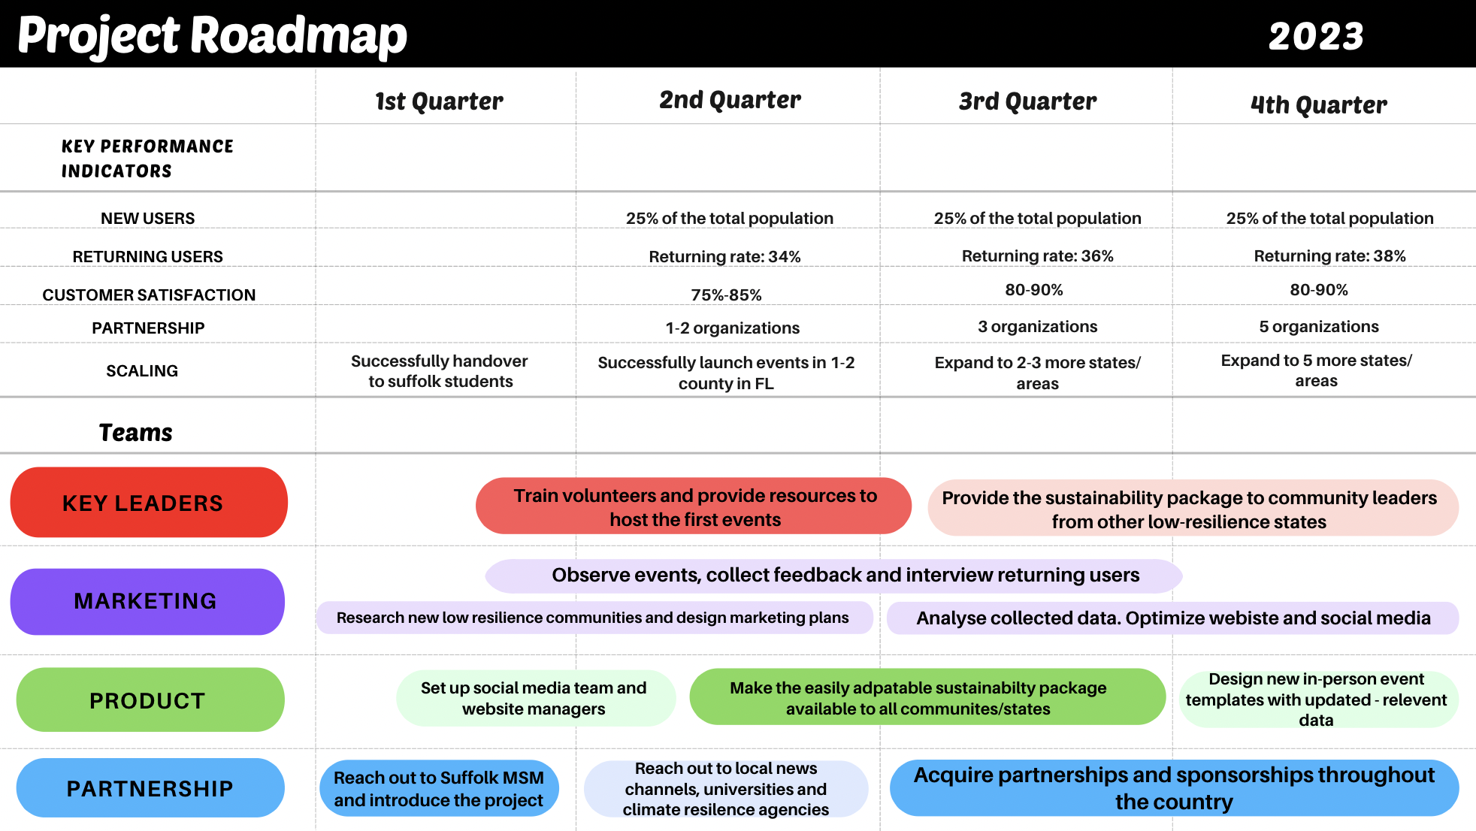
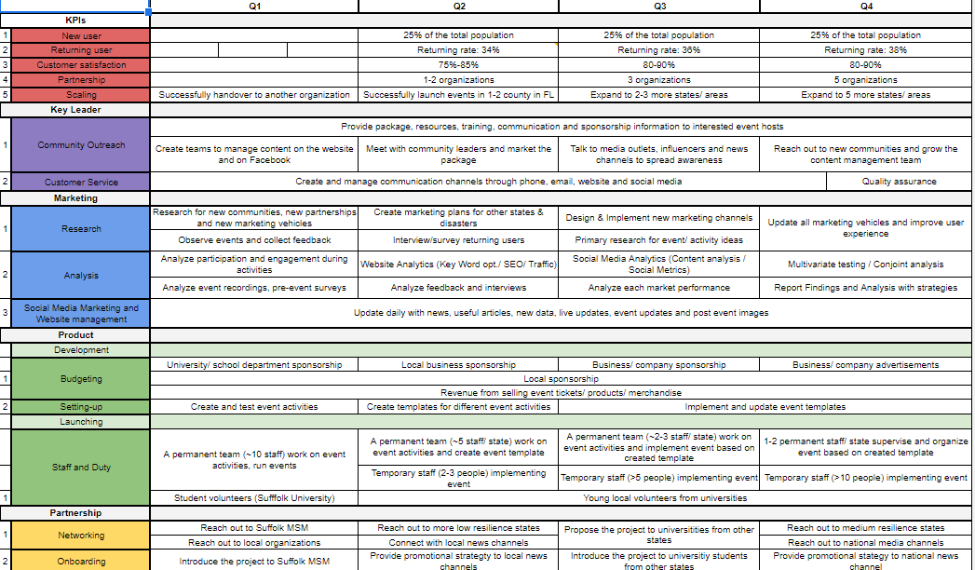
ROADMAP
APPENDIX
Simplified version
Notes:
Since we projected the customer satisfaction to increase by 6% every quarter, so does the returning users.
For Q1 our goal is to pass the project to suffolk students. Then in Q2, the goal is to reach our first target audience in a low resilience area (Host event). Q3 will be focusing on providing our sustainability package, that other states can use to easily replicate the event. Q4’s main goal is to find more sponsors and partners for the project.

Slide 26

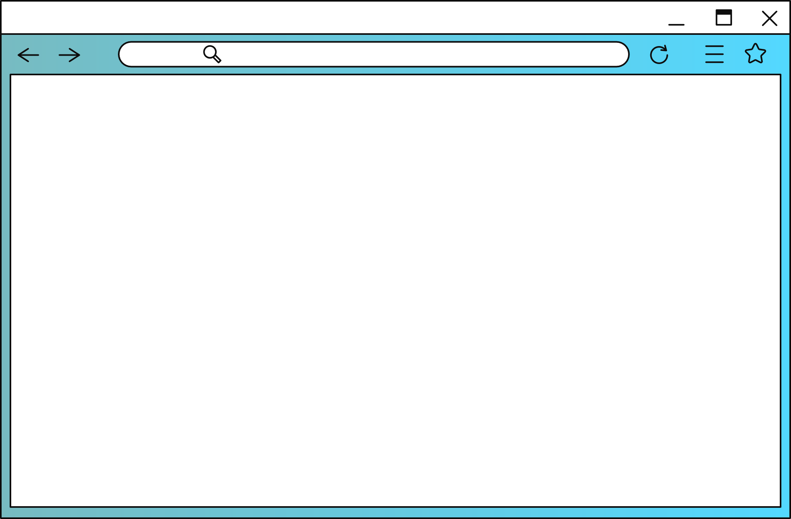




SUSTAINABILITY
CLIMATENOW.COM
Event Template
Event Themes
& Guides
Organization/
Sponsors
Data Resources
Notes:
On the website we created as a marketing channel, there will be a section like the example we show here.
In this section, we will provide the event template with all the information they need to hold this event, such as how to operate the activities we mentioned earlier and what tools they need. We also provided them with suggestions that can be used widely.
In the event themes and guide, we suggest to them other activities and themes that can be used instead of the original plan, such as for theme they can use the Squid Game model to mimic if they find it is suitable for their area. Or they can replace one of the activities with Jeopardy.
For organizations and sponsors, we suggest those who can support them financially, such as the department of elder affairs, charities, or big insurance companies. For example, in the location of our launch plan, Liberty Mutual is quite popular in the Florida area.
For data resources, we suggest reliable sources that can be used for research in advance and setting materials for activities. For example, FEMA The National Risk Index, Climate Mapping for Resilience and Adaptation, USGS, ArcGIS Living Atlas of the World, United State Census Bureau

Slide 27



